Slide 1
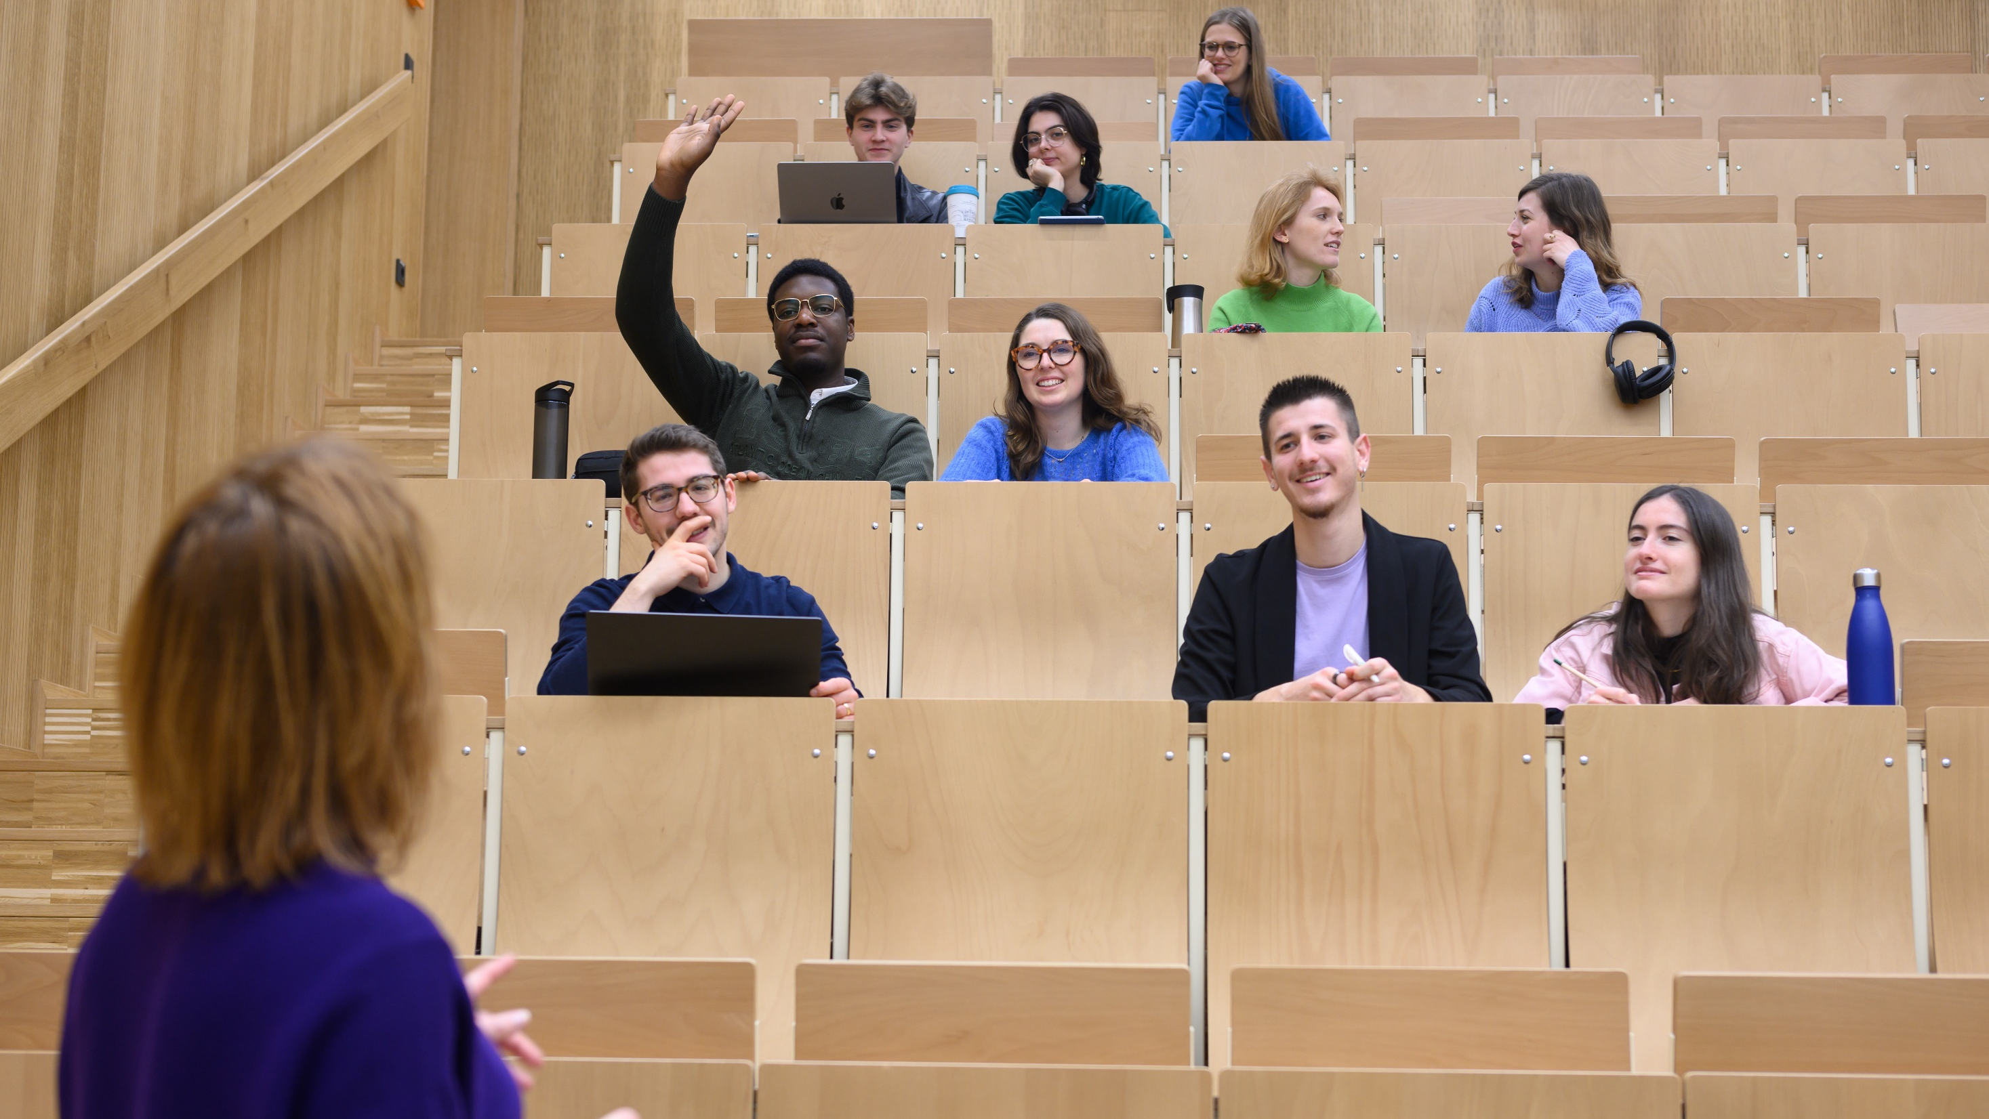
THE FRANCO-GERMAN UNIVERSITY (FGU)
One degree - Two countries – Two diplomas

Slide 2
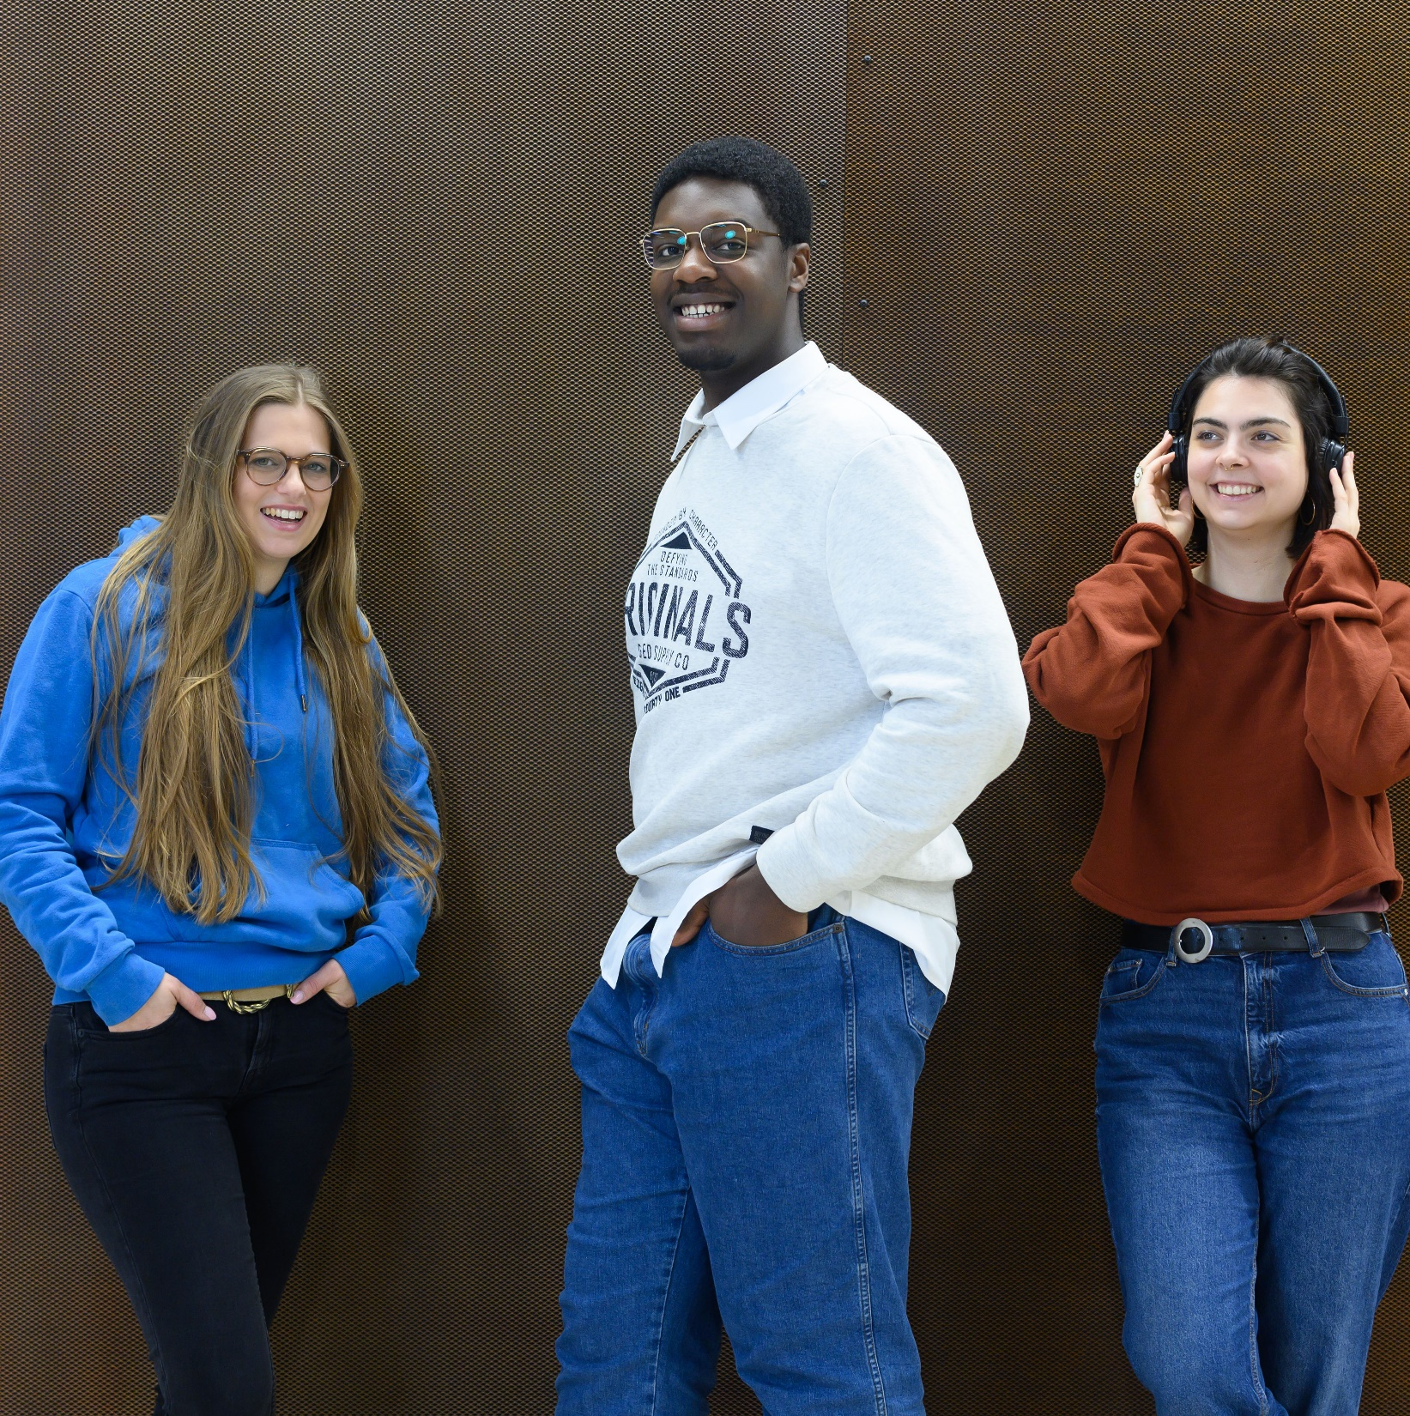
The FGU –
more than just a university

Slide 3
The FGU at a glance
• The FGU is a network of 210 affiliated member universities from Germany, France and third countries.
• Founded in 1997 by means of an intergovernmental agreement (Weimar Agreement)
• Administrative seat Saarbrucken
The FGU is an international organisation like no other.

Slide 4




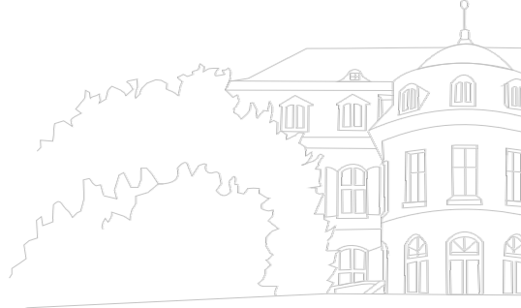


Key figures
210
universities in Germany and France, as well as in other partner countries
199
bi-national and tri-national courses in over 20 fields of study
5,810
students currently enrolled
26,941
graduates since our foundation
550
bi- and tri-national post-docs
4

Slide 5
• The FGU provides expert guidance on Franco-German university relations with the aim of enhancing university and research cooperation between the two countries.
• The FGU’s main tasks include initiating, coordinating and funding structured academic degree programmes for each of the three Bologna cycles.
• The degree programmes are subject to external academic evaluation by French and German experts.
Our mission
5

Slide 6
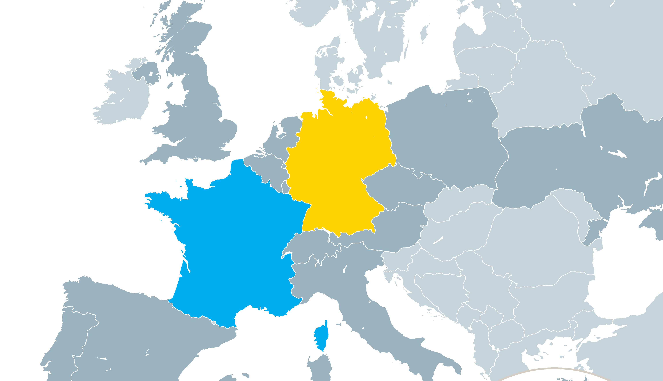
Our network:
135 university cities
6

Slide 7
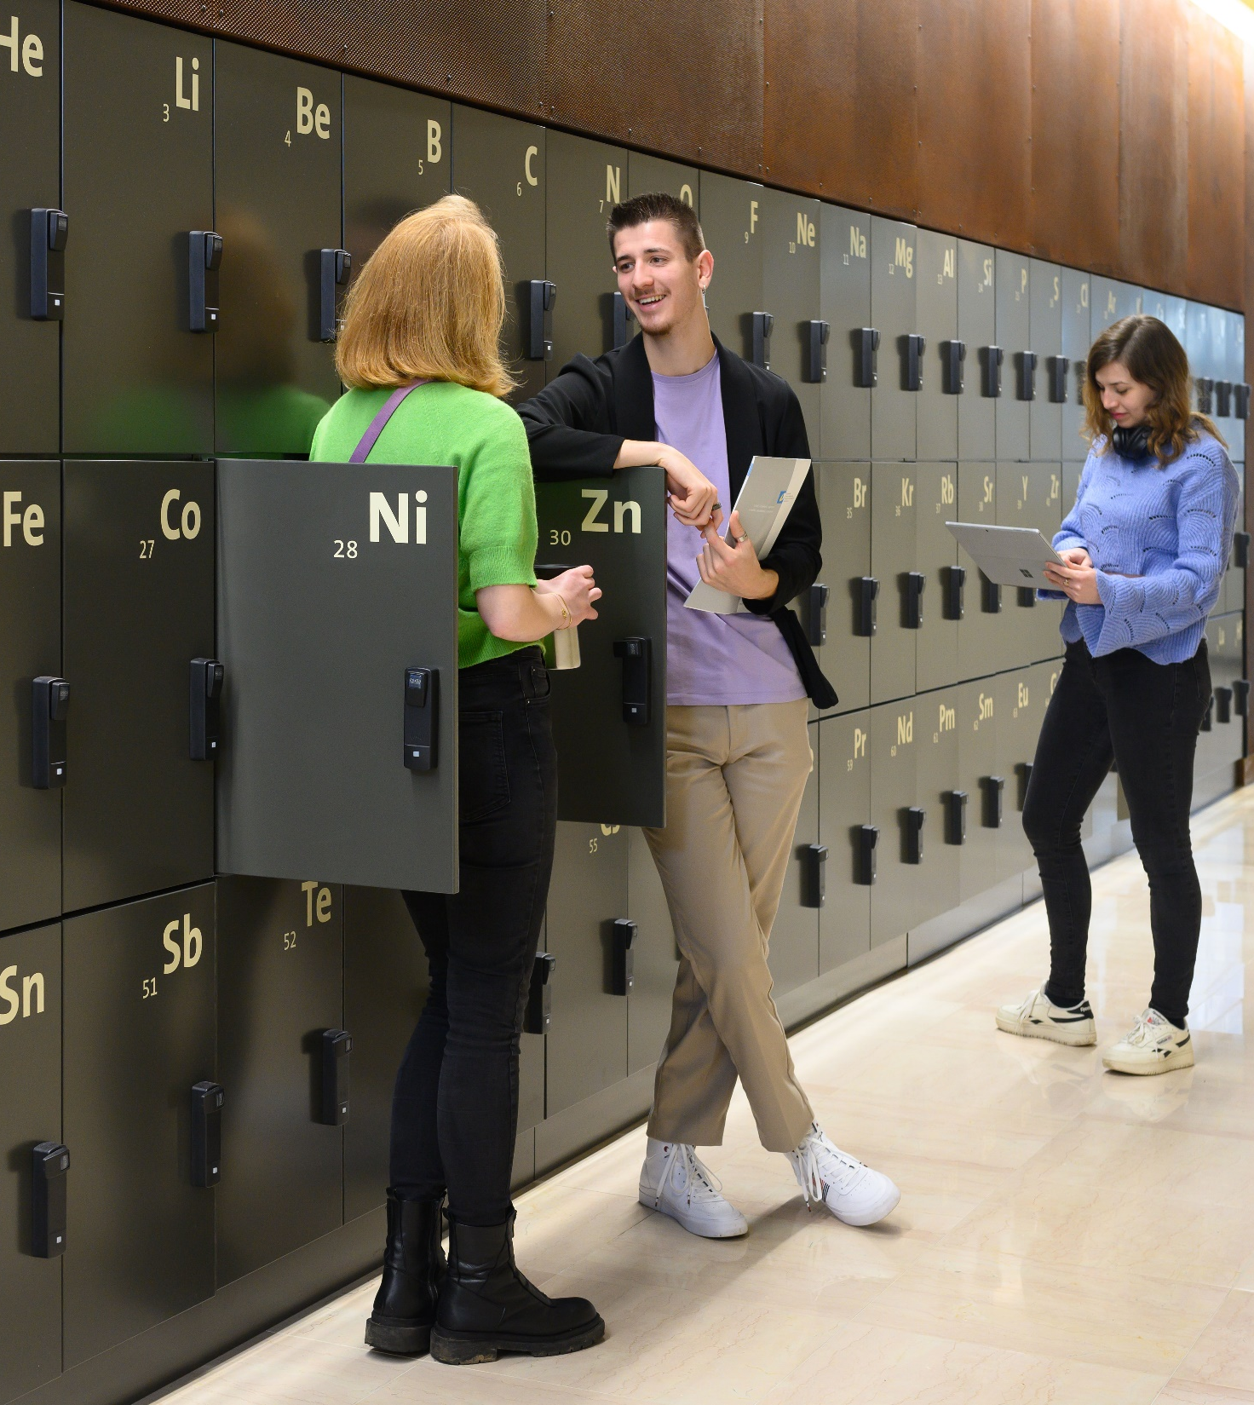
Our study programme...

Slide 8

... a huge selection at all levels
Bachelor's and Master's level: Integrated study programmes (bi- and tri-national) with double degrees
PhD: programmes to promote early career researchers (PhD tracks, doctoral programmes, jointly supervised dissertations (cotutelles de these), scientific/academic events)

Slide 9
... always innovative, thanks to regular new additions
New DFH degree programmes from winter semester 2024 | Locations and partner institutions | Level
Master's degree in social, work and organizational psychology | Landau (RPTU Kaiserslautern-Landau) Strasbourg (U Strasbourg) | Master
Master European Digital and Sustainable Business | Offenburg (HS Offenburg) Strasbourg (U Strasbourg) + Basel (FHNW Schweiz) | Master
Physical engineering and embedded systems | Stuttgart (U Stuttgart) Caen (ENSI Caen) | Master // Diplom
Integrated Bachelor's degree program for secondary level 1 teachers | Freiburg (PH Freiburg) Mulhouse (UHA Mulhouse) | Bachelor // Licence
European lawyer | Berlin (HU Berlin) Paris (U Paris-Panthéon-Assas) + Athen (U Athens) / Madrid (UAM) / Lisbon (U Católica Portuguesa) | Master
European and International Politics | Saarbrücken (U des Saarlandes) Strasbourg (U Strasbourg) | Master

Slide 10
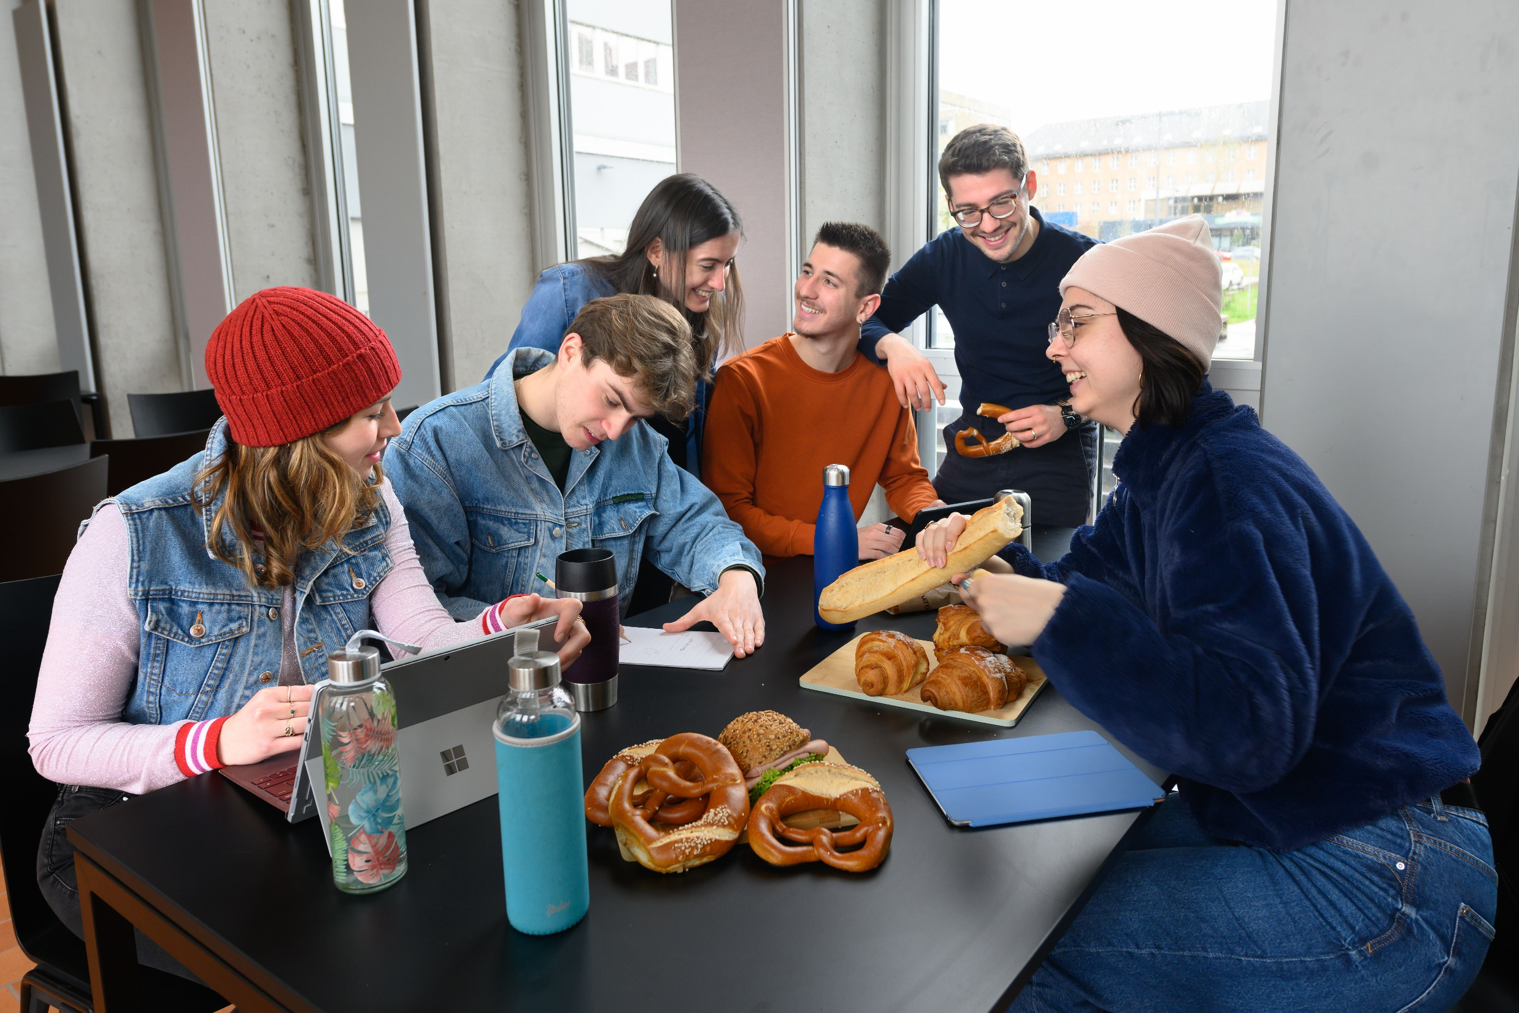

Why study French-German ?

Slide 11
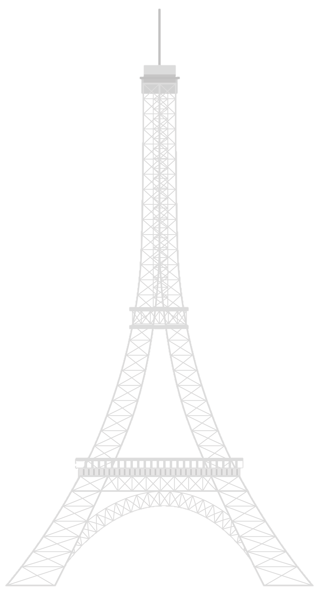

Your advantages at a glance
€ 350
Monthly mobility allowance
Cross-cultural experiences
Experience new cultures and build friendships for life
Double degree
without extending the standard period of study
Support
Targeted preparation and personal contacts in both countries
1 Year
at least spent abroad

Slide 12




Our additional offerings
Intercultural workshops: ideal preparation for finding work on the international job market
Excellence awards: awards for graduates who have demonstrated professional and cross-cultural excellence
Business contacts: cooperation with business players, joint events, scholarships
Alumni networks: financial and content-related support, broad network of interdisciplinary contacts

Slide 13
Paving the way for your development
Acquiring skills far beyond your studies
Excellent specialist knowledge
General & technical language skills
Experience abroad
First professional experience through internships
Flexibility & mobility
Commitment & resilience
Cross-cultural competence
Ability to work in a team
In short: incomparable personal development

Slide 14
Your career springboard
Your studies at the FGU:
a plus on the international job market!
A European educational pathway certified by the FGU
A perfect education to succeed and develop in an international job market
A European and international network and cross-cultural application training for your entry into the job market

Slide 15
Briefly summarised
The FGU is a network of over 210 universities.
You study simultaneously at a German and a French university and receive a double degree.
You can choose from 199 degree programmes in 135 cities.
The FGU supports your stay abroad with 350 euros per month.
The double degree is your career springboard.

Slide 16

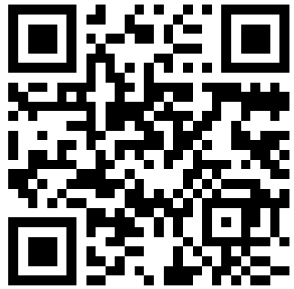
How do I apply?
Simply scan this QR code
and you will be taken to our interactive online study guide. There you will find all the information you need about applying, the course of study, programme content and, of course, the right contacts at our partner institutions.

Slide 17
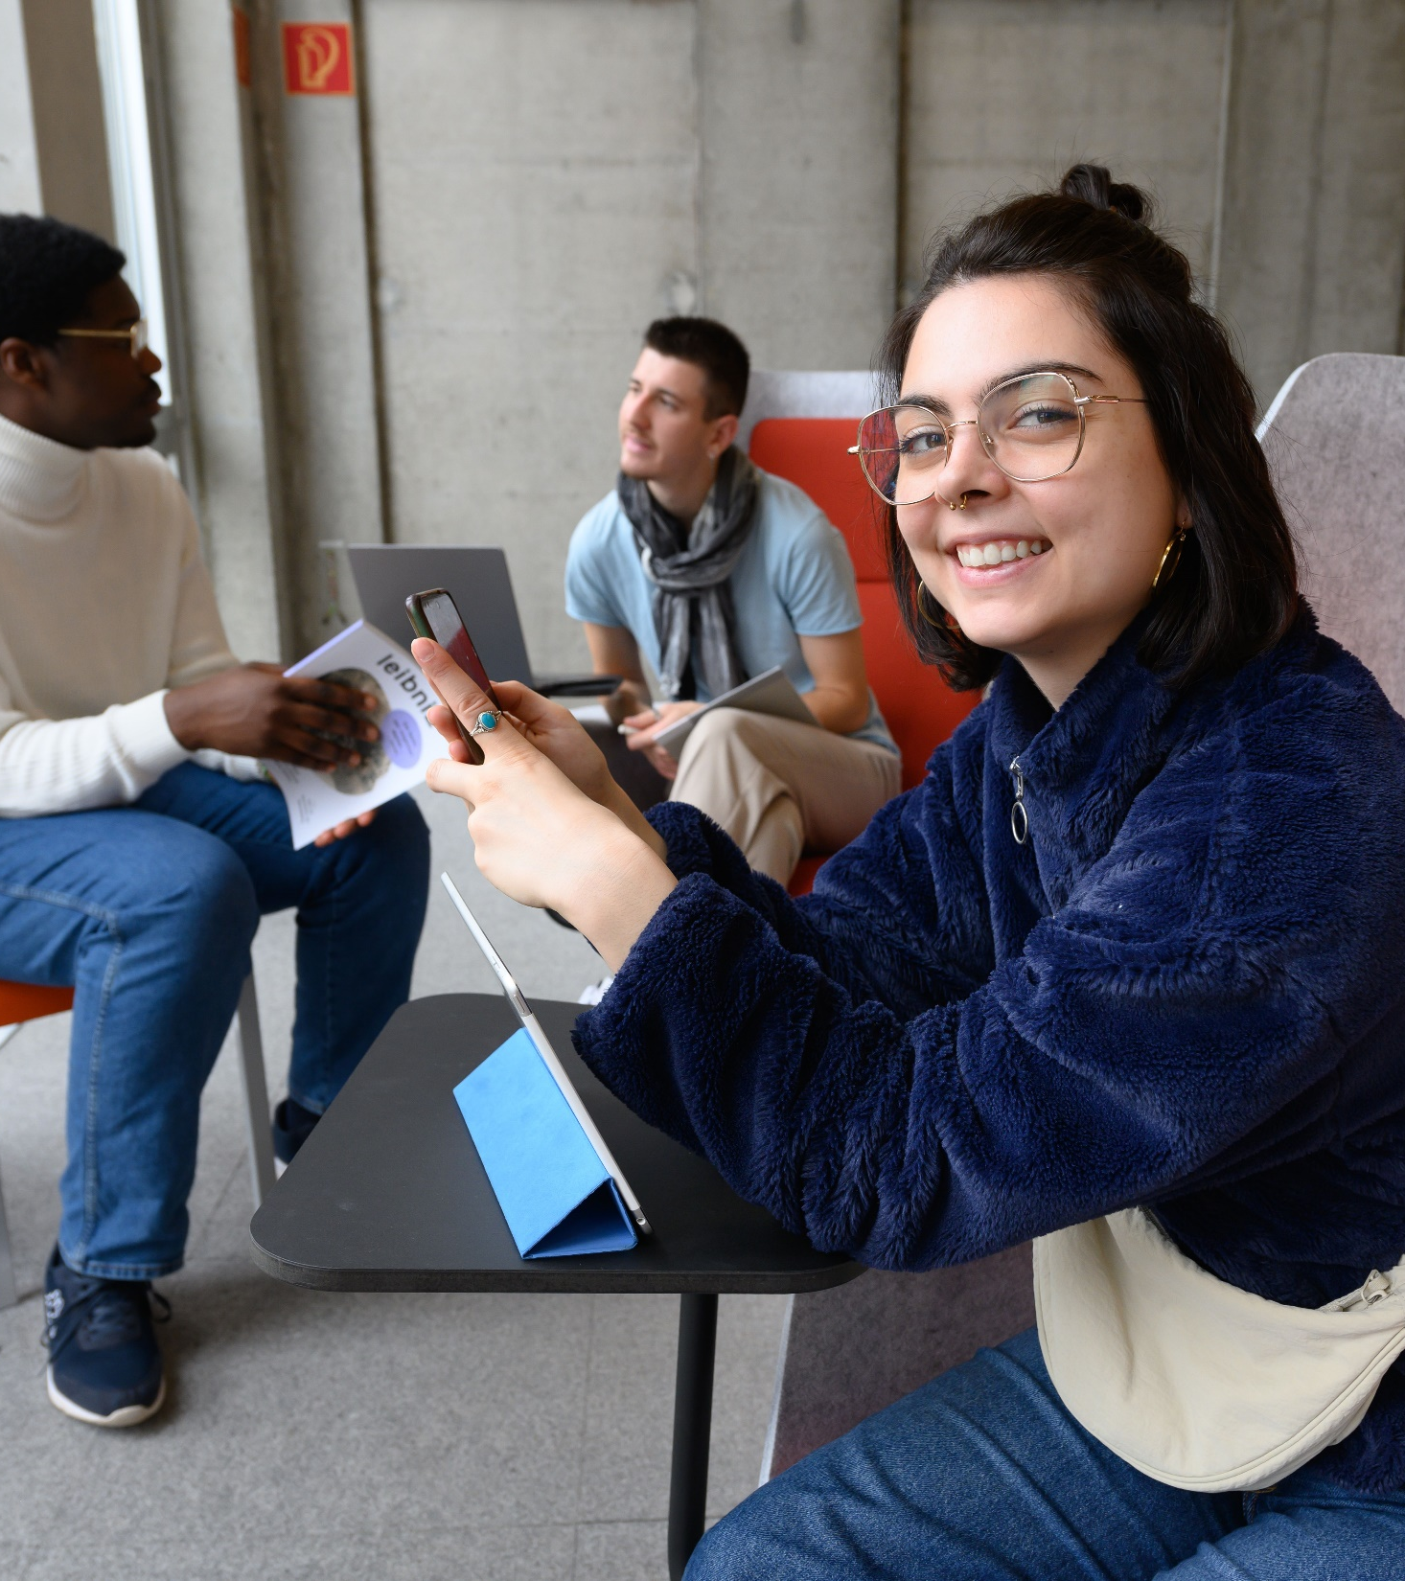
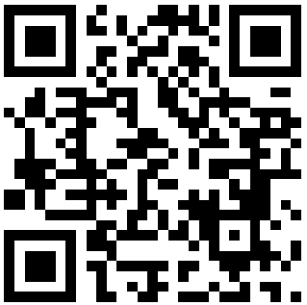
For more information and insights, follow us on Instagram !

Slide 18
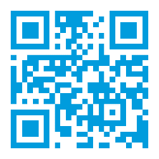

Université franco-allemande
Deutsch-Französische Hochschule
Franco-German University
Villa Europa · Kohlweg 7 · 66123 Saarbrücken
Tel.: +49 681 93812 - 100
info@dfh-ufa.org
www.dfh-ufa.org
Thank you for your attention !
Follow us on

